Slide 1

25AIC114
Elements of Computing – 2 (Assembly Programming)
PROJECT TITLE:
“Program Execution & Resource Monitoring System”
GROUP 9:
Dhiren Vasudeva(CB.AI.U4CPS25014)
Pardhav Reddy(CB.AI.U4CPS25059)
Poovya.S(CB.AI.U4CPS25061)
Ch.Venkata Abhiram(CB.AI.U4CPS25012)
Edwin Santosh(CB.AI.U4CPS25045)
1

Slide 2
Contents of presentation
  Introduction and Motivation
  Problem Statement
  Project Objectives
  Tools & Technologies Used
  Modular System Architecture
  Engine: Trace Hook Execution
  Modular: Resource Telemetry
  Perforamnce Visualization
  Intelligent Insights
  Comparative Results
  Individual Contributions
  Limitations & Future Work
  Conclusion
2

Slide 3
Introduction
In computer science education, understanding how a program actually runs in backend is often a major hurdle for learners. While students are taught the theoretical concepts of instruction execution, control flow, and memory management, the actual runtime behavior of these programs remains invisible in standard development environments.
3

Slide 4
Problem Statement
Understanding the internal mechanics of program execution is a significant challenge for students and developers because runtime behaviors—such as instruction flow, memory allocation, and dynamic variable changes—remain invisible in traditional environments. While these concepts are taught theoretically, there is a lack of integrated tools that simultaneously trace code execution line-by-line while providing real-time visualization of system resource consumption, such as CPU and RAM usage
4

Slide 5
Literature Review
S.No | Paper | Main Idea | Limitation
1 | CrossCode: Multi-level Visualization of Program Execution (2023) | Visualizes program execution at different abstraction levels to help understand program behavior. | Focuses mainly on visualization, not system resource monitoring.
2 | Educational Program Visualization Using Execution Information (2024) | Uses execution traces to visualize program operations like array reads and writes. | Restricted only for education purpose.
3 | Graph-Based Program Visualization (Cal Poly Thesis) | Uses graphs to represent program flow and function interactions. | Does not monitor runtime performance metrics.
4 | Software Visualization (Stony Brook Report) | Explains techniques to visualize software structure and execution behavior. | Mostly theoretical with limited implementation.
5 | Program Visualization in Computer Science Education | Shows that visualization improves understanding of programming concepts. | Focused on learning rather than performance monitoring.
5

Slide 6
Objectives
The main objectives of this project are:
• Monitor program execution step-by-step
• Track function calls and returns
• Observe variable value changes during runtime
• Measure CPU usage and RAM usage
• Measure execution time and memory consumption
• Visualize execution behavior using graphs
6

Slide 7
Tools & Technologies Used
  Programming Language
  Python
  Libraries Used
  sys: Used for execution tracing using sys.settrace().
  os: Used for file handling and locating the user program.
  tracemalloc: Tracks memory allocation and peak memory usage.
  psutil: Used for monitoring CPU usage, RAM usage, and process memory.
  time: Used to measure execution time.
  matplotlib: Used to generate performance graphs for analysis.
  GPU utilization
7

Slide 8
Improvements after Mid-Review
  Interactive UI (Streamlit-based IDE)
  Real-time execution tracking
  Graph visualization
  Call stack visualization
  Variable timeline tracking
  Program comparison system
  Insights engine
8

Slide 9
UI Transformation
Before:
•Terminal-based output
•Hard to understand
After:
•Full IDE interface
•Visual panels:
•Code editor
•Console
•Graphs
•Variables
•Call stack
9

Slide 10
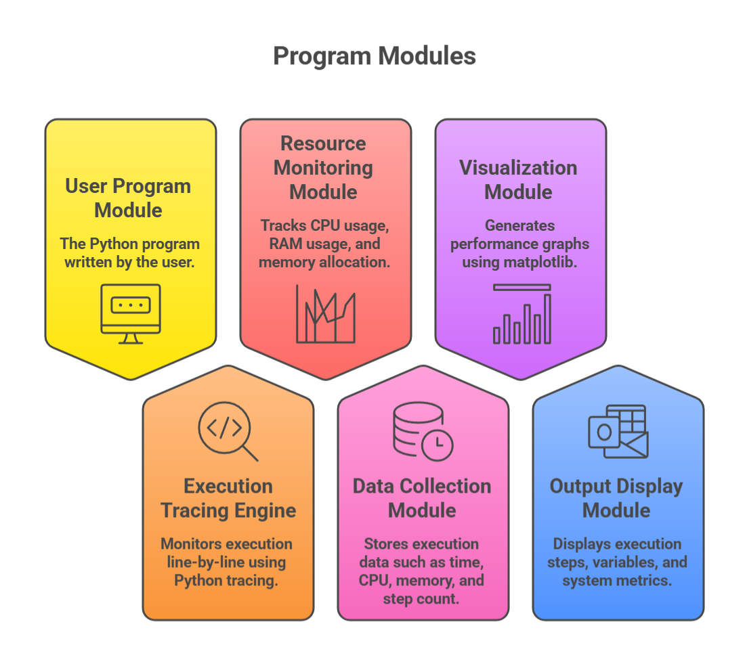
System Architecture
10

Slide 11
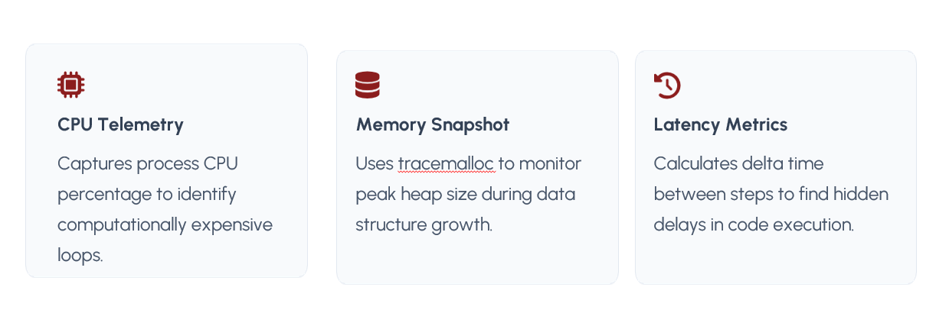


Resource Monitoring Module
CPU Telemetry
Captures process CPU percentage to identify
computationally expensive loops.
Memory Snapshot
Uses tracemalloc to monitor peak heap size during data structure growth.
Latency Metrics
Calculates delta time between steps to find hidden delays in code execution.
11

Slide 12
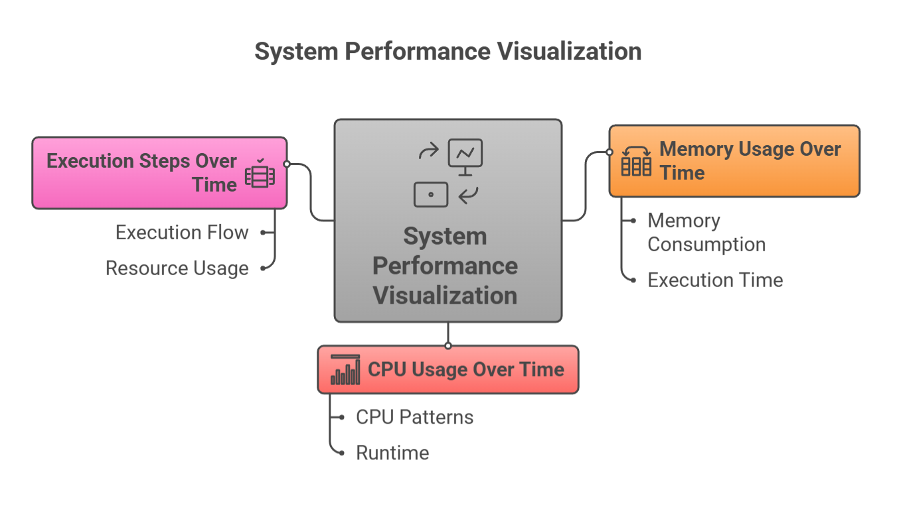
Performance Visualization
12

Slide 13
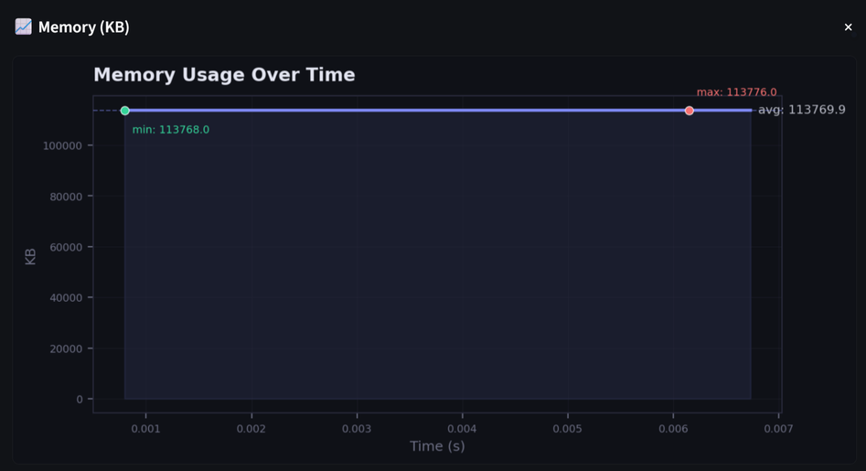
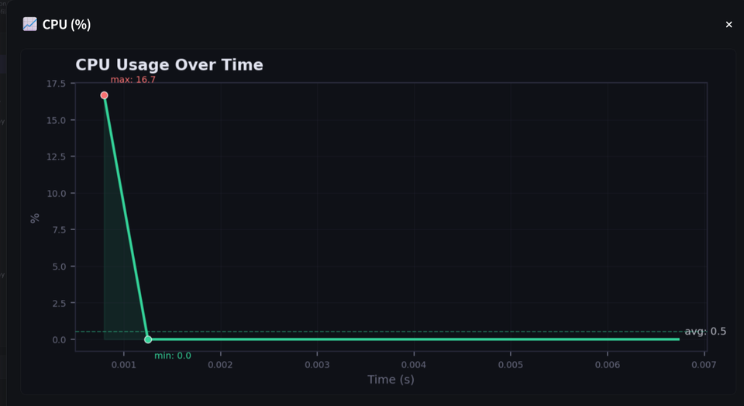
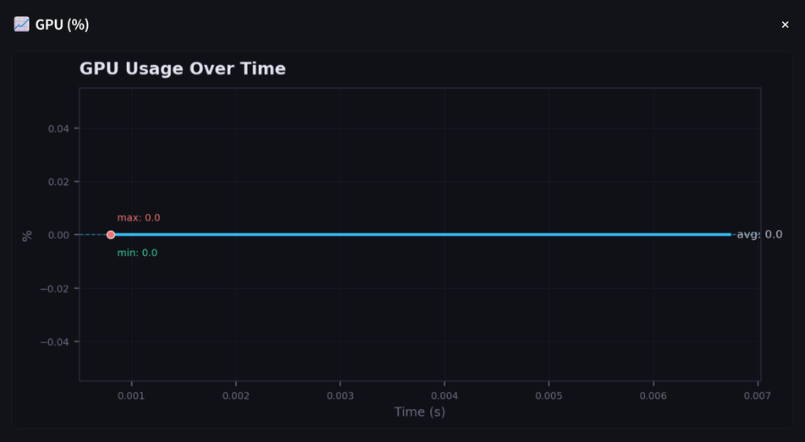
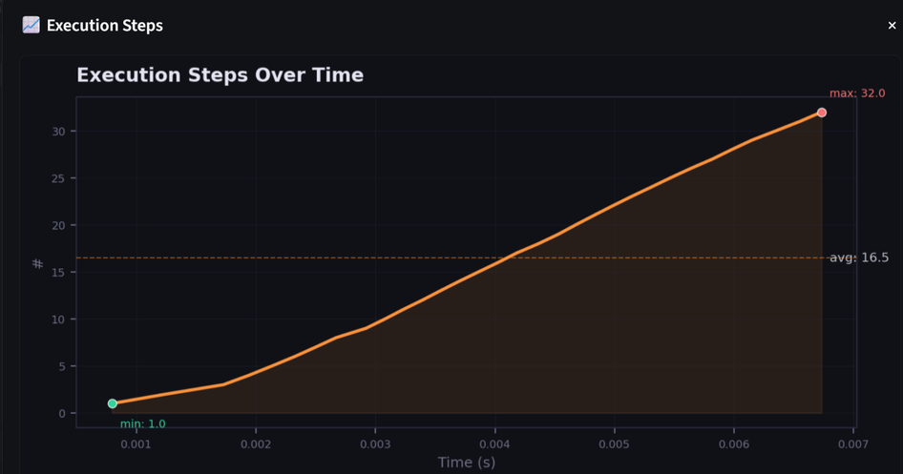
System Visualization
13

Slide 14
Multi-language Integration
•We extended the system to support:
•Execution of programs in multiple languages
Current focus:
•Python (fully supported)
•C/C++
•Java and JavaScript
14

Slide 15
Multi-language Design Approach
•Use subprocess-based execution
•Language-specific runners
•Unified output format
•Same visualization pipeline
15

Slide 16
Individual Contributions
Member | Contribution
Poovya S | Research and literature review on program execution analysis and monitoring techniques
Ch.Venkata Abhiram | System architecture design and execution tracing implementation
Dhiren | Runtime behavior analysis, execution flow monitoring, and variable tracking
Pardhav Redyy | Resource monitoring module development (CPU, RAM, memory tracking) and code integration
Edwin Santosh | Performance graph visualization, system testing, and documentation
16

Slide 17
Conclusion
The proposed system successfully demonstrates how programs execute internally and how system resources are utilized during execution.
By combining execution tracing with resource monitoring and visualization, the system helps users understand program behavior and performance more effectively.
17

Slide 18
THANK YOU
18

